Slide 1
Firewalls

Slide 2
What is a Firewall?
A choke point of control and monitoring
Interconnects networks with differing trust
Imposes restrictions on network services
  only authorized traffic is allowed
Auditing and controlling access
  can implement alarms for abnormal behavior
Itself immune to penetration
Provides perimeter defence

Slide 3
Classification of Firewall
Characterized by protocol level it controls in
Packet filtering
Circuit gateways
Application gateways
Combination of above is dynamic packet filter

Slide 4
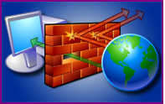

What is Windows Firewall?
Windows Firewall helps protecting your computer by preventing unauthorized users from gaining access to your computer through a network or internet.
GO BACK

Slide 5
What does it do
Help block computer viruses and worms from reaching your computer.
Ask for your permission to block or unblock certain connection requests.
Create a record (a security log)
GO BACK

Slide 6
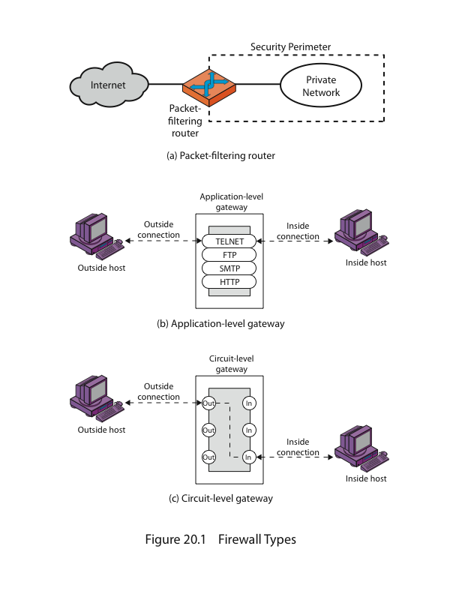
Firewalls – Packet Filters

Slide 7
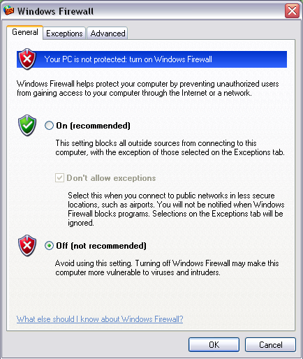
What does it do
GO BACK

Slide 8
Router Firewall
  Hardware firewall
  Difference between Hardware firewall and Software firewall:
  Configuring for maximum security
  Strengthening Home router firewalls
  Block ICMP traffic, or 'stealth' mode:
  Stateful packet inspection:
  Disable remote administration
  Attack detection:
  Disable file and printer sharing
GO BACK

Slide 9
Router Firewall
  Hardware firewall
  Difference between Hardware firewall and Software firewall:
  Configuring for maximum security
  Strengthening Home router firewalls
  Block ICMP traffic, or 'stealth' mode:
  Stateful packet inspection:
  Disable remote administration
  Attack detection:
  Disable file and printer sharing
GO BACK

Slide 10
Router Firewall
  Hardware firewall
  Difference between Hardware firewall and Software firewall:
  Configuring for maximum security
  Strengthening Home router firewalls
  Block ICMP traffic, or 'stealth' mode:
  Stateful packet inspection:
  Disable remote administration
  Attack detection:
  Disable file and printer sharing
GO BACK

Slide 11
Firewalls – Packet Filters
Simplest of components
Uses transport-layer information only
  IP Source Address, Destination Address
  Protocol/Next Header (TCP, UDP, ICMP, etc)
  TCP or UDP source & destination ports
  TCP Flags (SYN, ACK, FIN, RST, PSH, etc)
  ICMP message type
Examples
  DNS uses port 53
    No incoming port 53 packets except known trusted servers

Slide 12
Usage of Packet Filters
Filtering with incoming or outgoing interfaces
  E.g., Ingress filtering of spoofed IP addresses
  Egress filtering
Permits or denies certain services
  Requires intimate knowledge of TCP and UDP port utilization on a number of operating systems

Slide 13
How to Configure a Packet Filter
Start with a security policy
Specify allowable packets in terms of logical expressions on packet fields
Rewrite expressions in syntax supported by your vendor
General rules - least privilege
  All that is not expressly permitted is prohibited
  If you do not need it, eliminate it

Slide 14

Every ruleset is followed by an implicit rule reading like this.
Example 1:
Suppose we want to allow inbound mail (SMTP, port 25) but only to our gateway machine. Also suppose that mail from some particular site SPIGOT is to be blocked.

Slide 15

Solution 1:
Example 2:
Now suppose that we want to implement the policy “any inside host can send mail to the outside”.

Slide 16

Solution 2:
This solution allows calls to come from any port on an inside machine, and will direct them to port 25 on the outside. Simple enough…
So why is it wrong?

Slide 17
Our defined restriction is based solely on the outside host’s port number, which we have no way of controlling.
Now an enemy can access any internal machines and port by originating his call from port 25 on the outside machine.
What can be a better solution ?

Slide 18

The ACK signifies that the packet is part of an ongoing conversation
Packets without the ACK are connection establishment messages, which we are only permitting from internal hosts

Slide 19
Security & Performance of Packet Filters
IP address spoofing
  Fake source address to be trusted
  Add filters on router to block
Tiny fragment attacks
  Split TCP header info over several tiny packets
  Either discard or reassemble before check
Degradation depends on number of rules applied at any point
Order rules so that most common traffic is dealt with first
Correctness is more important than speed

Slide 20
Port Numbering
TCP connection
  Server port is number less than 1024
  Client port is number between 1024 and 16383
Permanent assignment
  Ports <1024 assigned permanently
    20,21 for FTP 23 for Telnet
    25 for server SMTP 80 for HTTP
Variable use
  Ports >1024 must be available for client to make any connection
  This presents a limitation for stateless packet filtering
    If client wants to use port 2048, firewall must allow incoming traffic on this port
  Better: stateful filtering knows outgoing requests

Slide 21
Firewalls – Stateful Packet Filters
Traditional packet filters do not examine higher layer context
  ie matching return packets with outgoing flow
Stateful packet filters address this need
They examine each IP packet in context
  Keep track of client-server sessions
  Check each packet validly belongs to one
Hence are better able to detect bogus packets out of context
Notes:
A traditional packet filter makes filtering decisions on an individual packet basis and does not take into consideration any higher layer context. A stateful inspection packet filter tightens up the rules for TCP traffic by creating a directory of outbound TCP connections, and will allow incoming traffic to high-numbered ports only for those packets that fit the profile of one of the entries in this directory. Hence they are better able to detect bogus packets sent out of context.

Slide 22
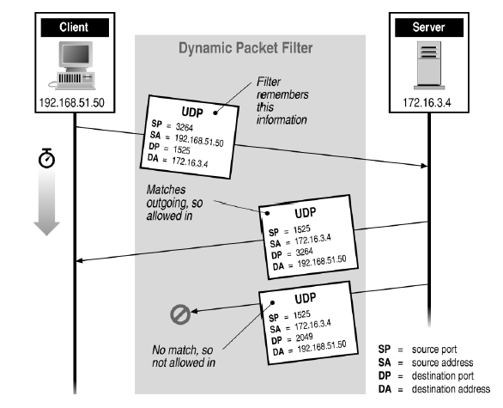
Stateful Filtering

Slide 23
Firewall Outlines
Packet filtering
Application gateways
Circuit gateways
Combination of above is dynamic packet filter

Slide 24
Firewall Gateways
Firewall runs set of proxy programs
  Proxies filter incoming, outgoing packets
  All incoming traffic directed to firewall
  All outgoing traffic appears to come from firewall
Policy embedded in proxy programs
Two kinds of proxies
  Application-level gateways/proxies
    Tailored to http, ftp, smtp, etc.
  Circuit-level gateways/proxies
    Working on TCP level
Notes:
Gateway is like a NAT box, ie, a home router.

Slide 25
Firewalls - Application Level Gateway (or Proxy)

Slide 26
Application-Level Filtering
Has full access to protocol
  user requests service from proxy
  proxy validates request as legal
  then actions request and returns result to user
Need separate proxies for each service
  E.g., SMTP (E-Mail)
  NNTP (Net news)
  DNS (Domain Name System)
  NTP (Network Time Protocol)
  custom services generally not supported

Slide 27
App-level Firewall Architecture
FTP proxy
Telnet proxy
SMTP proxy
Telnet daemon
FTP daemon
SMTP daemon
Network Connection
Daemon spawns proxy when communication detected …

Slide 28
Enforce policy for specific protocols
E.g., Virus scanning for SMTP
  Need to understand MIME, encoding, Zip archives

Slide 29
Firewall Outlines
Packet filtering
Application gateways
Circuit gateways
Combination of above is dynamic packet filter

Slide 30
Firewalls - Circuit Level Gateway

Slide 31
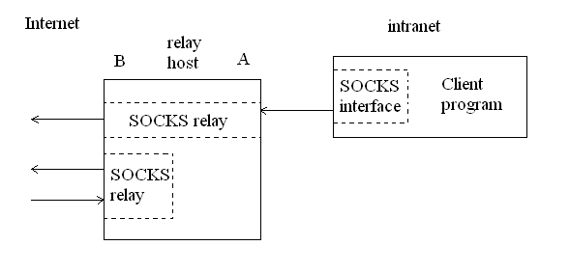
Figure 9.7: A typical SOCKS connection through interface A, and rogue connection through the external interface, B.

Slide 32
Bastion Host
Highly secure host system
Potentially exposed to "hostile" elements
Hence is secured to withstand this
  Disable all non-required services; keep it simple
Trusted to enforce trusted separation between network connections
Runs circuit / application level gateways
  Install/modify services you want
Or provides externally accessible services

Slide 33
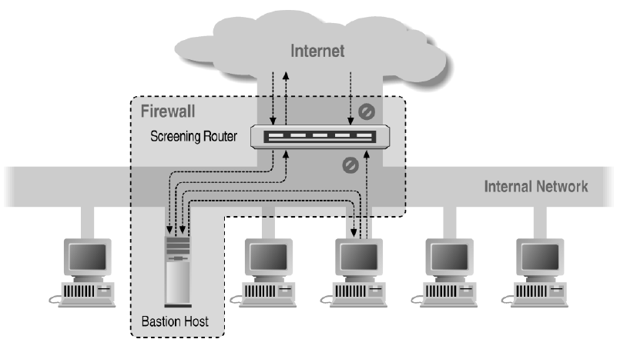
Screened Host Architecture

Slide 34
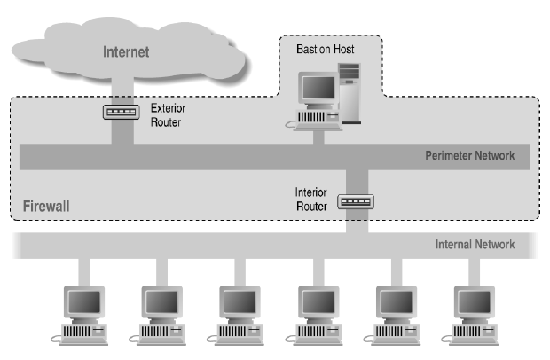
Screened Subnet Using Two Routers

Slide 35
Firewalls Aren’t Perfect?
Useless against attacks from the inside
  Evildoer exists on inside
  Malicious code is executed on an internal machine
Organizations with greater insider threat
  Banks and Military
Protection must exist at each layer
  Assess risks of threats at every layer
Cannot protect against transfer of all virus infected programs or files
  because of huge range of O/S & file types

Slide 36
Quiz
In this question, we explore some applications and limitations of a stateless packet filtering firewall. For each of the question, briefly explain how the firewall should be configured to defend against the attack, or why the firewall cannot defend against the attack.
  Can the firewall prevent a SYN flood denial-of-service attack from the external network?
  Can the firewall prevent a Smurf attack from the external network? Recall that as we discussed in the class before, the Smurf attack uses the broadcast IP address of the subnet.

Slide 37
  Can the firewall prevent external users from exploiting a security bug in a CGI script on an internal web server (the web server is serving requests from the Internet)?
  Can the firewall prevent an online password dictionary attack from the external network on the telnet port of an internal machine?
  Can the firewall prevent a user on the external network from opening a window on an X server in the internal network? Recall that by default an X server listens for connections on port 6000
  Can the firewall block a virus embedded in an incoming email?
  Can the firewall be used to block users on the internal network from browsing a specific external IP address?

Slide 38
Backup Slides

Slide 39
Firewalls - Circuit Level Gateway
Relays two TCP connections
Imposes security by limiting which such connections are allowed
Once created usually relays traffic without examining contents
Typically used when trust internal users by allowing general outbound connections
SOCKS commonly used for this
Notes:
One advantage over normal packet filters: the IP addr is changed. So no internal IP addr is leaked out.
A circuit-level gateway relays two TCP connections, one between itself and an inside TCP user, and the other between itself and a TCP user on an outside host. Once the two connections are established, it relays TCP data from one connection to the other without examining its contents. The security function consists of determining which connections will be allowed. It is typically used when internal users are trusted to decide what external services to access.
One of the most common circuit-level gateways is SOCKS, defined in RFC 1928. It consists of a SOCKS server on the firewall, and a SOCKS library & SOCKS-aware applications on internal clients.

Slide 40
Firewall Outlines
Packet filtering
Application gateways
Circuit gateways
Combination of above is dynamic packet filter

Slide 41
Dynamic Packet Filters
Most common
Provide good administrators protection and full transparency
Network given full control over traffic
Captures semantics of a connection

Slide 42
1.2.3.4
5.6.7.8
1.2.3.4
5.6.7.8
Firewall
Intended connection from 1.2.3.4 to 5.6.7.8
Redialing on a dynamic packet filter. The dashed arrow
shows the intended connection; the solid arrows show the actual
connections, to and from the relay in the firewall box. The
Firewall impersonates each endpoint to the other.

Slide 43
Application
Proxy
5.6.7.8
10.11.12.13
5.6.7.8
1.2.3.4
Firewall
Intended connection from 1.2.3.4 to 5.6.7.8
A dynamic packet filter with an application proxy. Note the change in source address

Slide 44
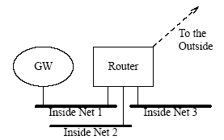
Network Topology
Filter Rule: Open access to Net 2 means source address from Net 3
  Why not spoof address from Net 3?
Figure 9.2: A firewall router with multiple internal networks.

Slide 45
Address-Spoofing
Detection is virtually impossible unless source-address filtering and logging are done
One should not trust hosts outside of one’s administrative control

Slide 46
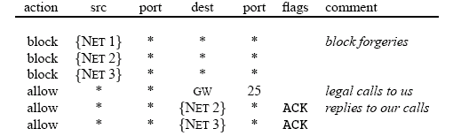
External Interface Ruleset
Allow outgoing calls, permit incoming calls only for mail and only to gateway GW
Note: Specify GW as destination host instead of Net 1
to prevent open access to Net 1

Slide 47
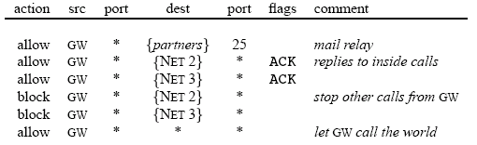
Net 1 Router Interface Ruleset
Gateway machine speaks directly only to other machines running trusted mail server software
Relay machines used to call out to GW to pick up waiting mail
Note: Spoofing is avoided with the specification of GW

Slide 48
How Many Routers Do We Need?
If routers only support outgoing filtering, we need two:
  One to use ruleset that protects against compromised gateways
  One to use ruleset that guards against address forgery and restricts access to gateway machine
An input filter on one port is exactly equivalent to an output filter on the other port
If you trust the network provider, you can go without input filters
  Filtering can be done on the output side of the router

Slide 49
Routing Filters
All nodes are somehow reachable from the Internet
Routers need to be able to control what routes they advertise over various interfaces
Clients who employ IP source routing make it possible to reach ‘unreachable’ hosts
  Enables address-spoofing
  Block source routing at borders, not at backbone

Slide 50
Routing Filters (cont)
Packet filters obviate the need for route filters
Route filtering becomes difficult or impossible in the presence of complex technologies
Route squatting – using unofficial IP addresses inside firewalls that belong to someone else
Difficult to choose non-addressed address space

Slide 51
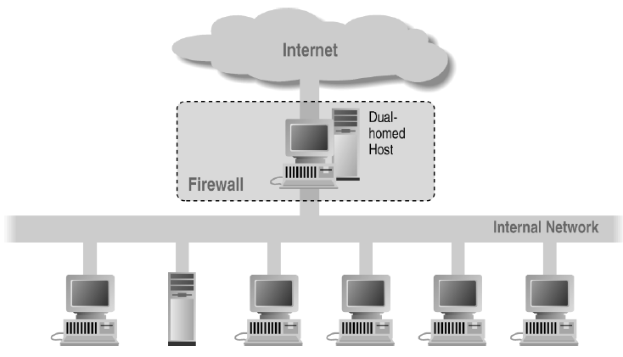
Dual Homed Host Architecture

Slide 52
Asymmetric Routes
Both sides of the firewall know nothing of one another’s topology
Solutions:
  Maintain full knowledge of the topology
    Not feasible, too much state to keep
  Multiple firewalls share state information
    Volume of messages may be prohibitive, code complexity

Slide 53
Are Dynamic Packet Filters Safe?
Comparable to that of circuit gateways, as long as the implementation strategy is simple
If administrative interfaces use physical network ports as the highest-level construct
  Legal connections are generally defined in terms of the physical topology
Not if evildoers exist on the inside
  Circuit or application gateways demand user authentication for outbound traffic and are therefore more resistant to this threat

Slide 54
Distributed Firewalls
A central management node sets the security policy enforced by individual hosts
Combination of high-level policy specification with file distribution mechanism
Advantages:
  Lack of central point of failure
  Ability to protect machines outside topologically isolated space
  Great for laptops
Disadvantage:
  Harder to allow in certain services, whereas it’s easy to block

Slide 55
Distributed Firewalls Drawback
Allowing in certain services works if and only if you’re sure the address can’t be spoofed
  Requires anti-spoofing protection
  Must maintain ability to roam safely
Solution: IPsec
  A machine is trusted if and only if it can perform proper cryptographic authentication

Slide 56
Where to Filter?
Balance between risk and costs
Always a higher layer that is hard to filter
  Humans

Slide 57
Dynamic Packet Filter Implementation
Dynamically update packet filter’s ruleset
  Changes may not be benign due to ordering
Redialing method offers greater assurance of security
  No special-case code necessary
  FTP handled with user-level daemon
  UDP handled just as TCP except for tear down
  ICMP handled with pseudoconnections and synthesized packets

Slide 58
Per-Interface Tables Consulted by Dynamic Packet Filter
Active Connection Table
  Socket structure decides whether data is copied to outside socket or sent to application proxy
Ordinary Filter Table
  Specifies which packets may pass in stateless manner
Dynamic Table
  Forces creation of local socket structures

